Slide 1
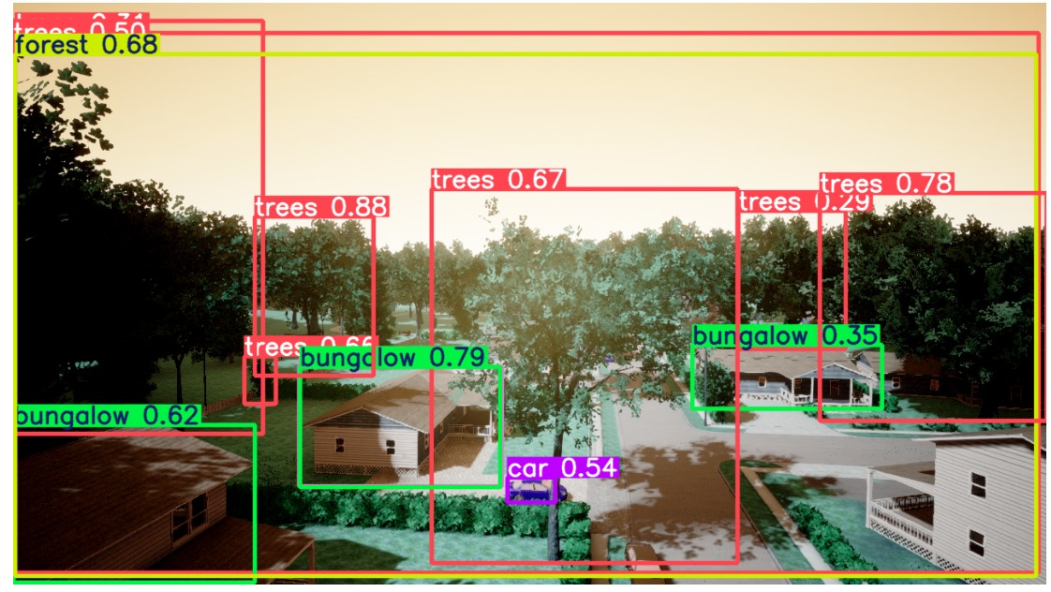
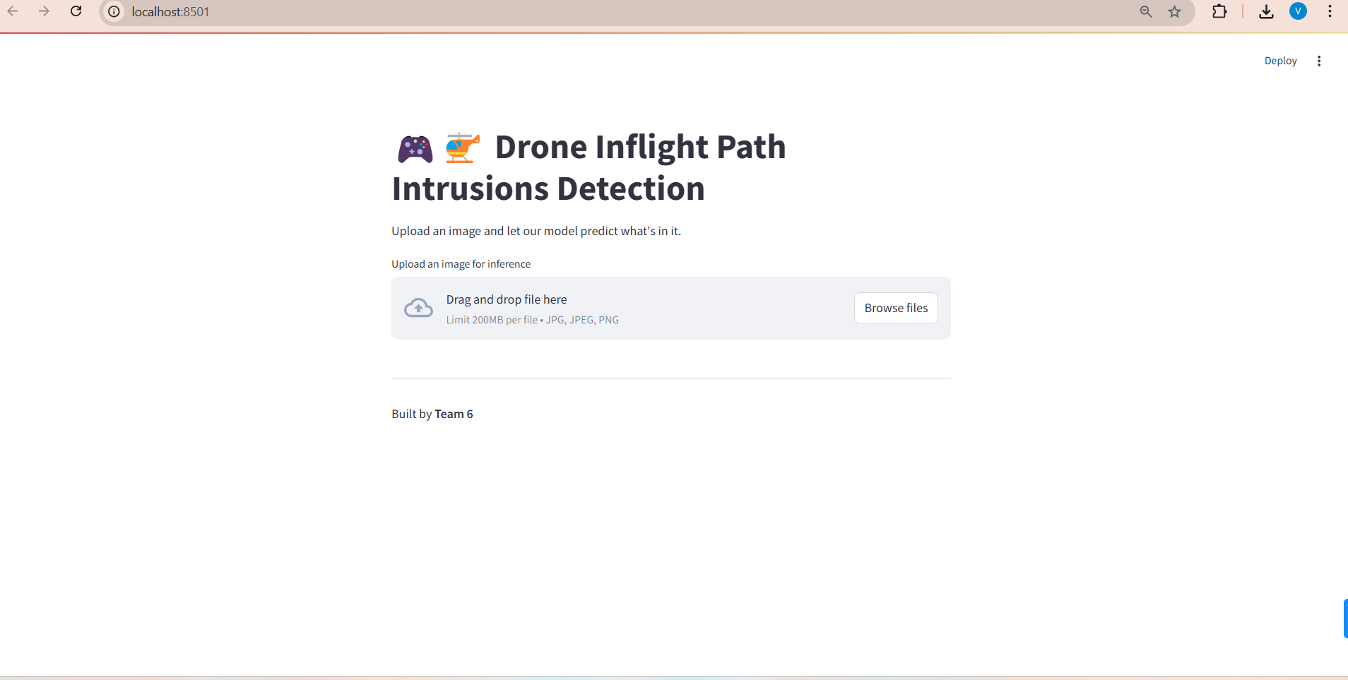
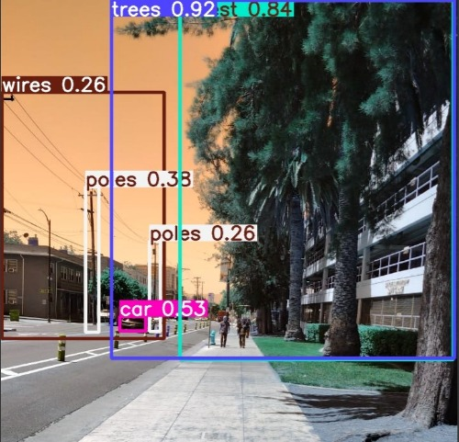
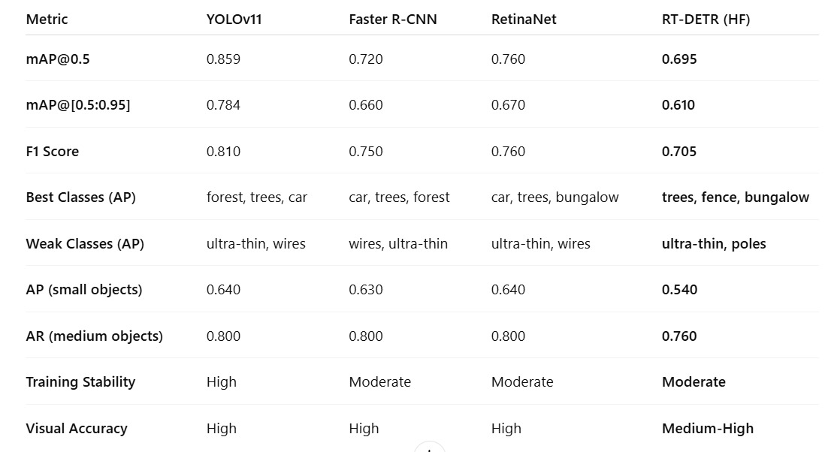
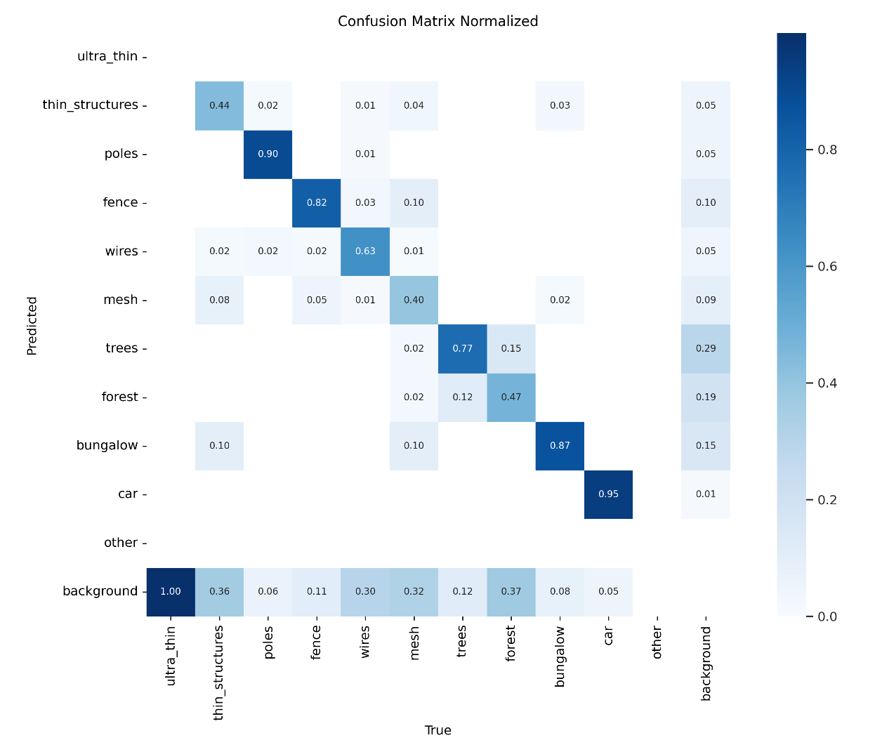
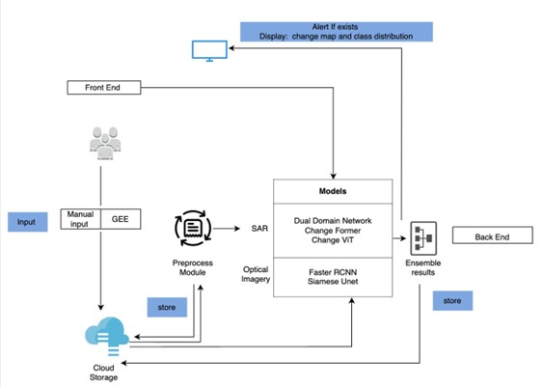
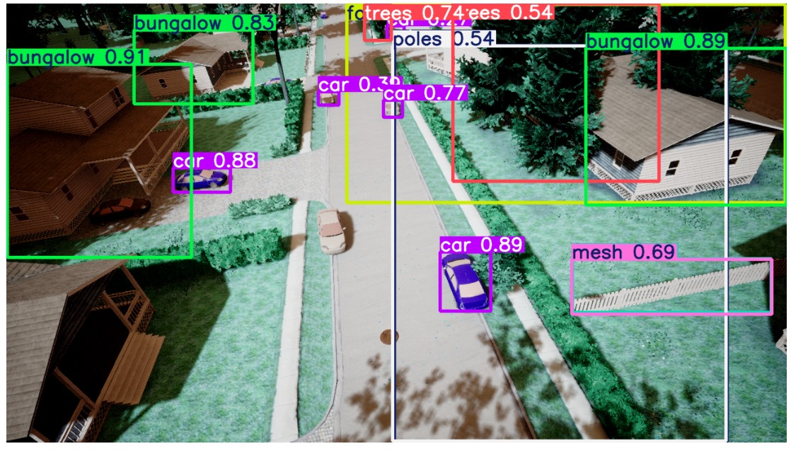
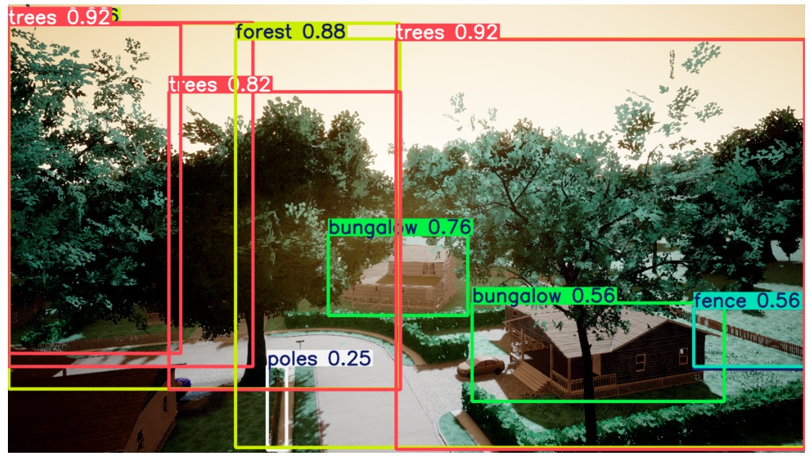
Applied Data Science Department
Obstacle Detection for Drone Flight Path
Project Advisor: Simon Shim
Sodha, Akshay
Somaiya, Harsh
Pagrut, Tanvi
Sharma, Vansh
Introduction
Analysis and Results
The user interface allows drone operators or analysts to upload aerial images for obstacle detection with a single click. Once uploaded, the system automatically processes the images using the YOLO v11 detection model and displays the results in real time.
The Obstacle Detection for Drone Flight Path project addresses the challenge of safe autonomous drone navigation by developing an advanced image-based detection system powered by deep learning. It processes aerial data to recognize and localize potential obstacles, enabling drones to adapt in real time to dynamic environments.
After training and evaluating all five models including YOLOv11, Faster R-CNN, RetinaNet, RT-DETRv3, and Grounding DINO, on the aerial imagery dataset, a comprehensive comparison was performed using metrics including mAP@0.5, mAP@[0.5:0.95], F1-score, class-wise AP, object size-specific AP, average recall, training stability, and visual accuracy.
RetinaNet handled urban objects well (car, bungalow), maintaining balanced accuracy across most categories.
RT-DETR (HF) had strong contextual understanding with the best performance on trees, fences, and bungalows, but underperformed on small or ultra-thin objects.
Grounding DINO was uniquely suited for zero-shot detection and language-based querying, but due to computational constraints, was not included in the main performance table.
Summary/Conclusions
This project built and tested a deep learning system for real-time obstacle detection in drones using five advanced models. YOLOv11 offered the highest real-time accuracy, while Faster R-CNN and RT DETR performed better in complex scenes. The models were evaluated using mAP and F1-score, with each excelling in different object categories. The system shows strong potential for safe drone navigation, though further improvement is needed for detecting ultra-thin and small obstacles.
The system combines multiple state-of-the-art models, each optimized for specific strengths such as speed, accuracy, or contextual understanding, to ensure robust performance across urban, rural, and natural settings. By integrating diverse model architectures and training on labeled drone imagery, this project offers a scalable and flexible solution for drone-based perception tasks, with applications in disaster response, infrastructure inspection, and autonomous delivery missions.
All models struggled with thin or low-contrast classes such as ultra-thin wires and poles. These classes had near-zero AP in most models, including YOLOv11 and RetinaNet, which otherwise performed well in broader detection.
This table highlights that YOLOv11 consistently outperformed other models in terms of mAP@0.5 (0.859), mAP@[0.5:0.95] (0.784), and F1 Score (0.81), achieving the highest balance between detection precision and recall. YOLOv11 also had strong average precision (AP) on small objects and medium-sized ones like trees and cars. Each model exhibited different strengths across obstacle classes:
Key References
[1] A. N and U. S V, "Drone Object Detection Using Deep Learning Algorithms," 2021 Third International Conference on Inventive Research in Computing Applications (ICIRCA), Coimbatore, India, 2021, pp. 1187-1192.
[2]Kolbeinsson, B., & Mikolajczyk, K. (2023). DDOS: The Drone Depth and Obstacle Segmentation Dataset. Huggingface Discussions
[3] Ren, S., He, K., Girshick, R., & Sun, J. (2015). Faster R-CNN: Towards real-time object detection with region proposal networks. NeurIPS..
[4] Lv, W., Xu, S., Zhao, Y., Wang, G., Wei, J., Cui, C., Du, Y., Dang, Q., & Liu, Y. (2023). DETRs Beat YOLOs on Real-time Object Detection.
Methodology
This project followed a deep learning pipeline to build a drone-based obstacle detection system. Aerial images were collected, preprocessed, and annotated using OpenCV, Roboflow, and Grounded SAM. Five models were trained on the labeled data using PyTorch and TensorFlow. The final system was deployed on Google Cloud with a Streamlit interface for real-time detection.
YOLOv11 excelled in detecting visually distinct, large or medium-sized objects like forest, trees, and cars. Its real-time performance combined with high spatial accuracy made it ideal for navigating open and semi-structured aerial environments.
Faster R-CNN was strong in partially occluded or complex structures like cars, trees, and forest but lagged on ultra-thin structures.
RT-DETRv3, though slightly lower on mAP (0.695 @0.5), showed robustness in semantic context and medium object detection, as reflected by its higher AR (0.76) and effectiveness in classes like fence and bungalow. However, its AR on small objects was the lowest at 0.540, limiting its utility in cluttered environments.
Trained YOLOv11, Faster R-CNN, RetinaNet, RT DETR v3, and Grounding DINO on annotated aerial datasets.
Preprocessed images using OpenCV for size normalization, brightness adjustment, and augmentation.
Refined annotations with Roboflow and Grounded SAM to improve obstacle detection accuracy.
Deployed the system using Google Cloud with a Streamlit UI and REST API for interactive use.
Acknowledgements
We sincerely thank Professor Simon Shim and the Department of Applied Data Science at San Jose State University for their continuous guidance and support. We are also grateful to our peers for their collaboration and valuable feedback throughout the project. This project allowed us to apply the skills and concepts learned during our coursework in a real-world context. We appreciate the opportunity to explore innovative solutions and contribute meaningfully to the academic community.
YOLOv11 had the highest training stability, fast convergence, and low overfitting.
Faster R-CNN and RetinaNet had moderate training stability and longer training cycles.
Visual accuracy remained High across most models, though RT-DETRv3 was rated Medium-High, owing to its semantic generalization at the cost of fine-grain spatial precision.

